Slide 1
Topic 1 : Basics of Web Analytics
ST2228 Web and Mobile Analytics

Slide 2
Learning Objectives
Basics of Web Analytics
Definition of Web Analytics(WA)
Describe the process of Web Analytics
Compare the strengths and shortfalls of various web analytics techniques

Slide 3
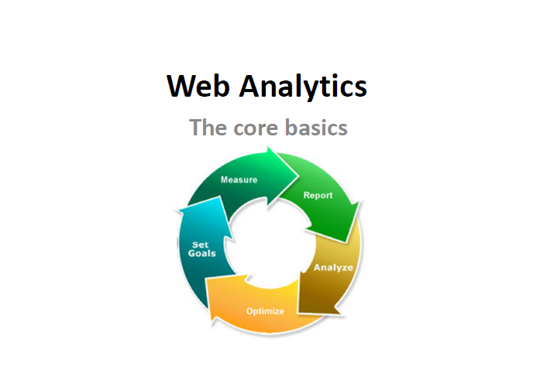
Web Analytics

Slide 4
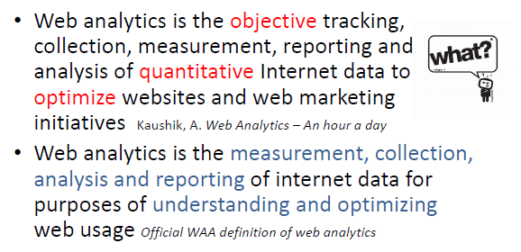
What is Web Analytics?

Slide 5
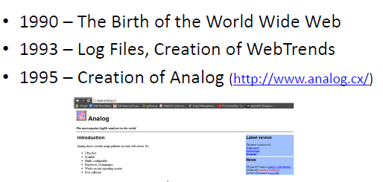
Brief History

Slide 6
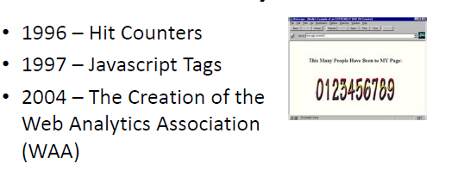
Brief History

Slide 7
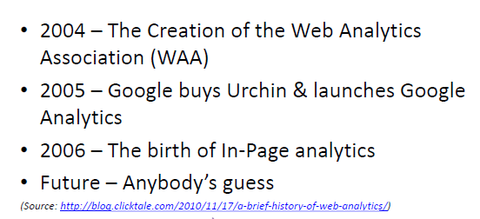
Brief History

Slide 8


Slide 9
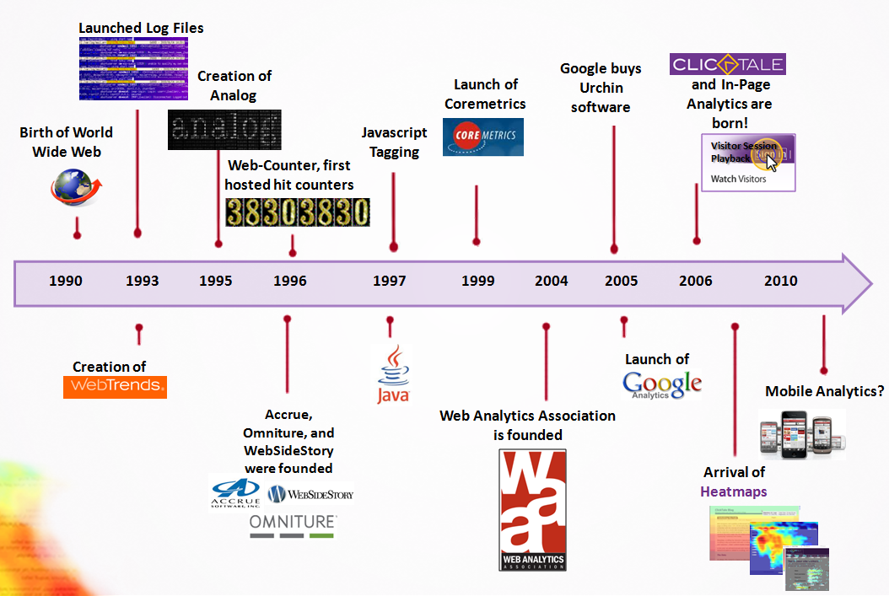
Brief History
Source: http://blog.clicktale.com/2010/11/17/a-brief-history-of-web-analytics/

Slide 10
Web Analytics 101
Is Web Analytics just Clickstream Analysis?
A clickstream is the recording of the parts of the screen a computer user clicks on while web browsing.
As the user clicks anywhere in the webpage or website, the action is logged on a web browser or inside the web server.
A clickstream is a series of page requests and every page requested generates a signal.
Clickstream Analysis gives webmasters insight into what visitors on their site are doing.

Slide 11
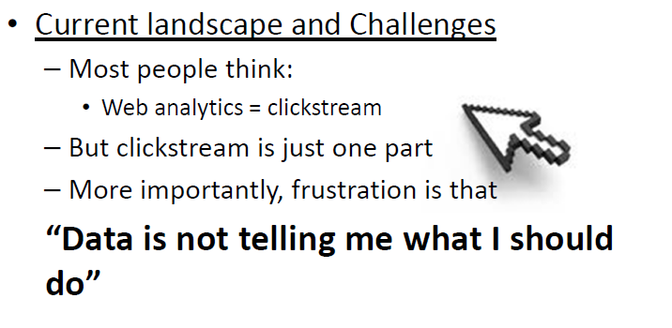
Web Analytics 101

Slide 12

Web Analytics 101
Current Landscape and Challenges
Problem of many WA vendors and their tools/features.
Problem of too much data.
Google Analytics changed the game, i.e. anybody can use this tool for free for their website.

Slide 13
What ?
+
Why ?

Slide 14
Fundamentals of WA
What happened?
Data collected (99%)
Clicks, Pages, time on site, paths, abandonment rate etc.
We are interested in the “WHY” –
Insight into the mind of our customers.
It is crucial to combine the what(quantitative) and the why(qualitative) together.

Slide 15
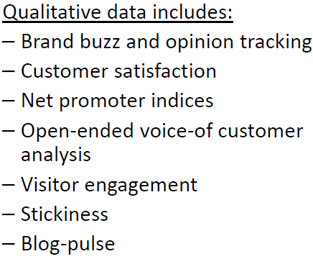
Fundamentals of WA

Slide 16
Clickstream
How to capture the clickstream Data?

Slide 17

How to capture the clickstream Data?

Slide 18
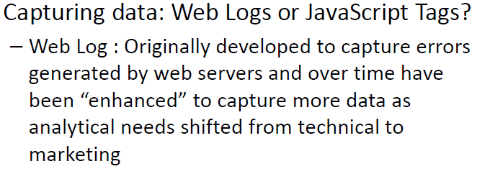
Data Capturing

Slide 19
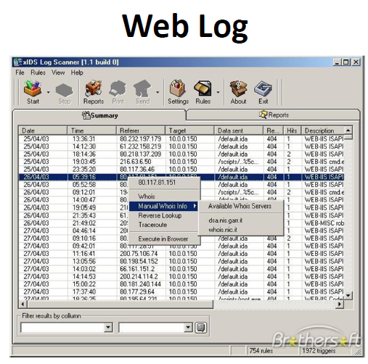
Data Capturing

Slide 20
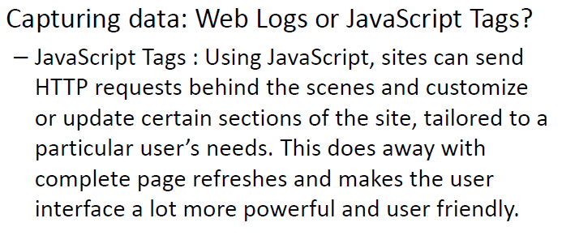
Data Capturing

Slide 21
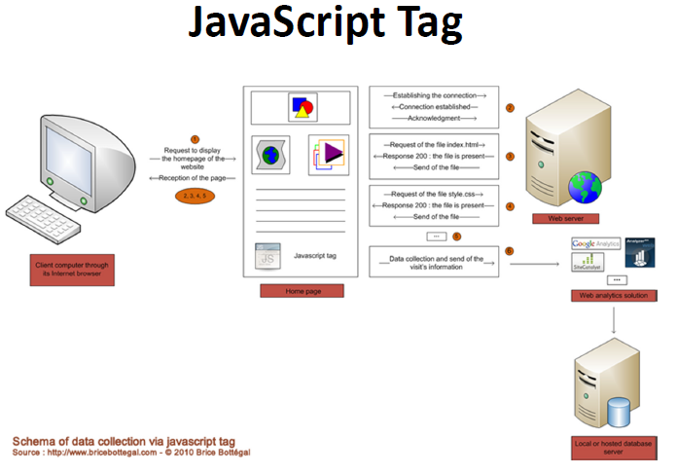
Data Capturing

Slide 22
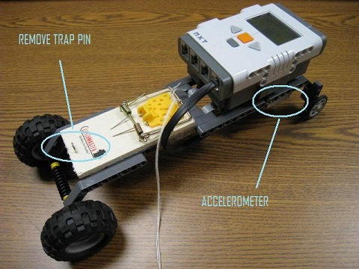

Slide 23
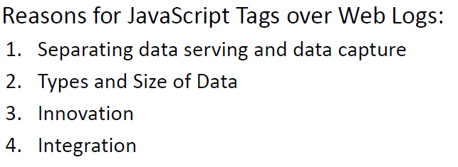
Data Capturing: Comparison of methods

Slide 24
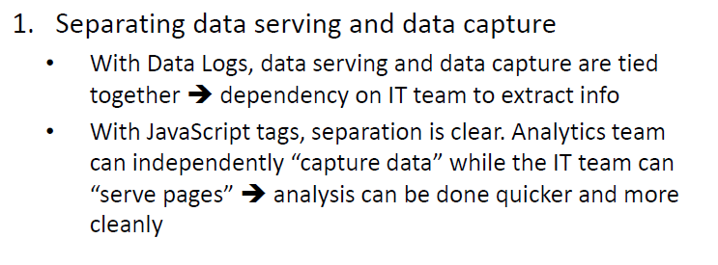
Data Capturing

Slide 25
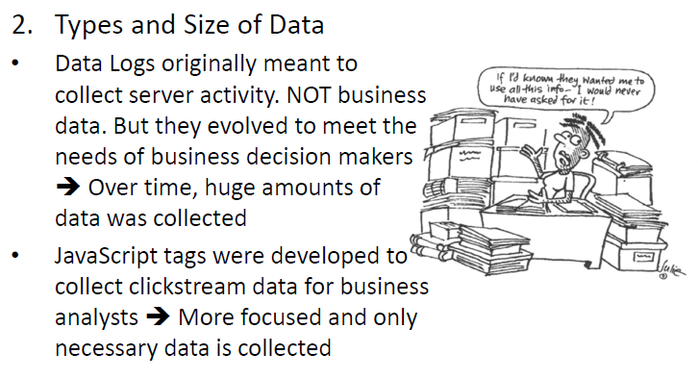
Data Capturing

Slide 26
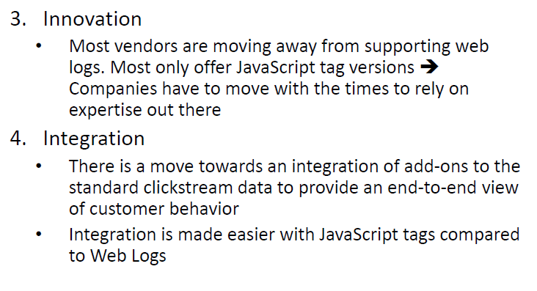
Data Capturing: Comparison

Slide 27
We can look at web analytics at different levels

Slide 28
Level 3: Experience Analysis
Level 2: Outcome Analysis
Level 1: Clickstream Analysis

Slide 29
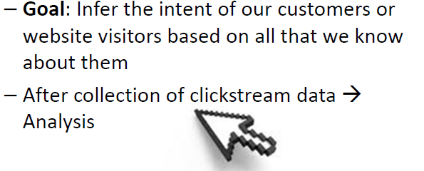
Fundamentals of WA
1. Clickstream Analysis

Slide 30
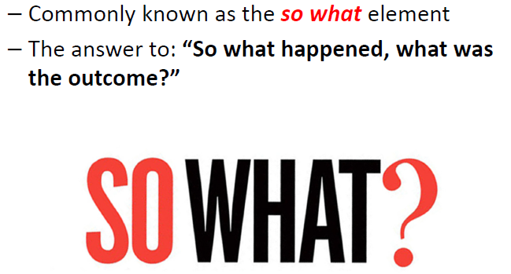
Fundamentals of WA
2. Outcome Analysis

Slide 31
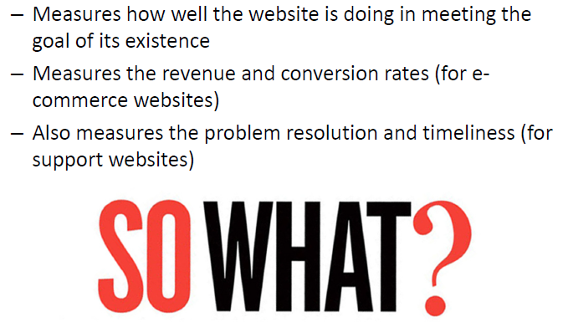
Fundamentals of WA
2. Outcome Analysis

Slide 32
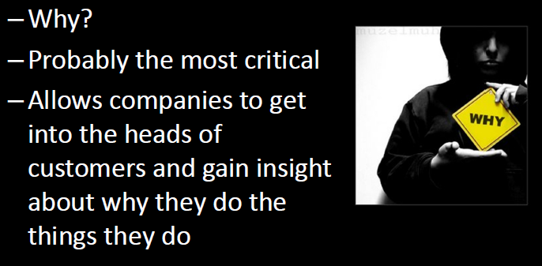
Fundamentals of WA
3. Experience Analysis

Slide 33
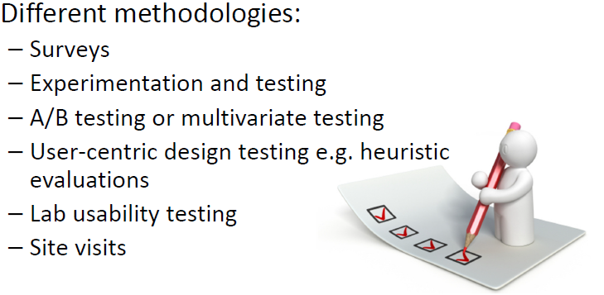
Fundamentals of WA
3. Experience Analysis

Slide 34
Viewed
as a
3 cornered
Cycle

Slide 35
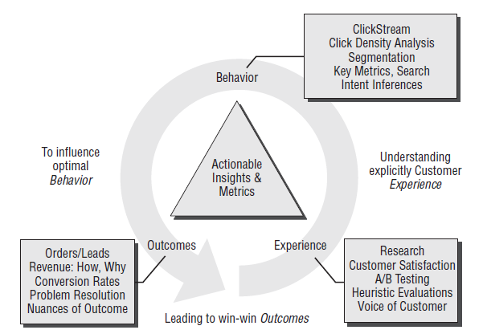
Trinity Strategy
Adapted from Web Analytics by Avinash Kaushik

Slide 36


